Slide 1
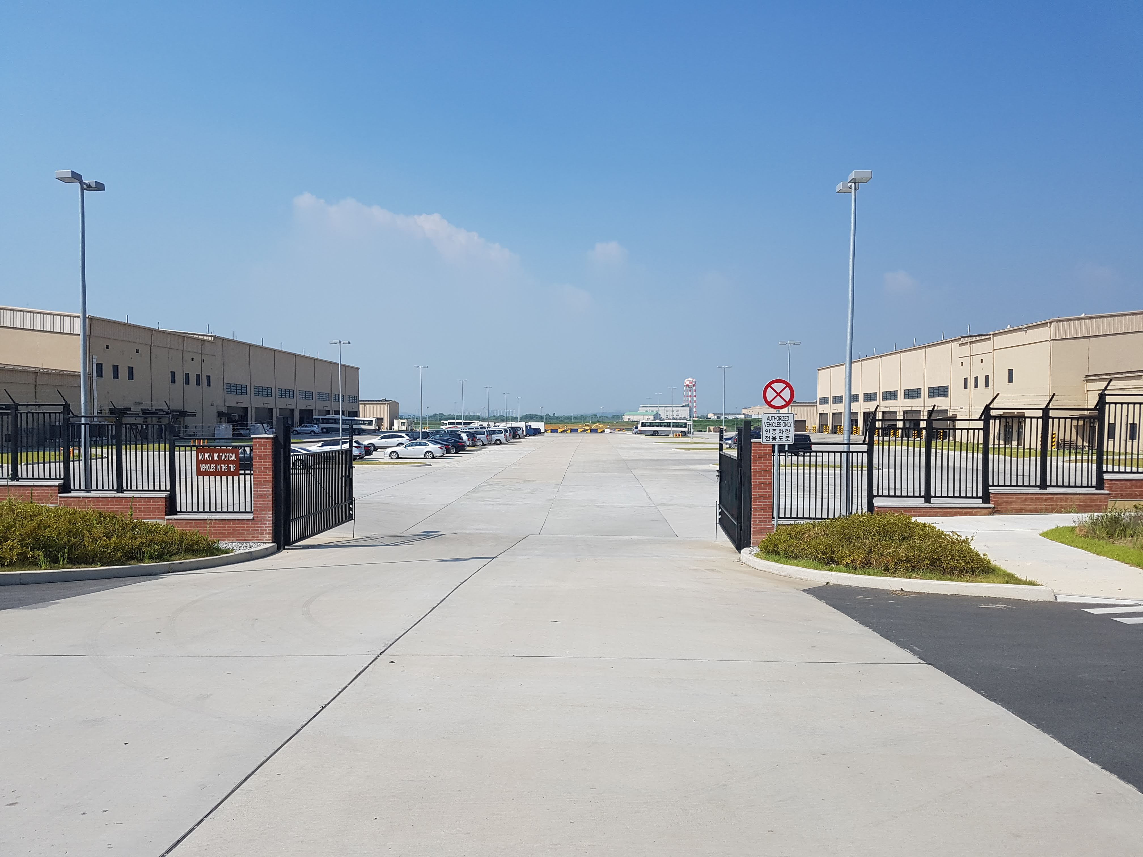
TMP Motor Pool Camp Humphreys
Drivers license testing/TMP rentals
TMP Shop Office

Slide 2
TMP Motor Pool Shop Office Side
Enter here go to 2nd Floor for shop office.

Slide 5
.

Slide 6




